Slide 1
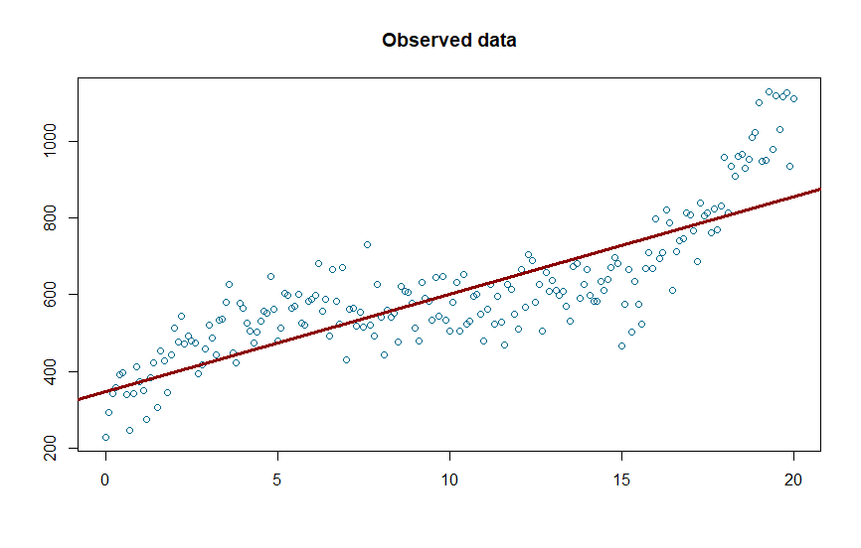
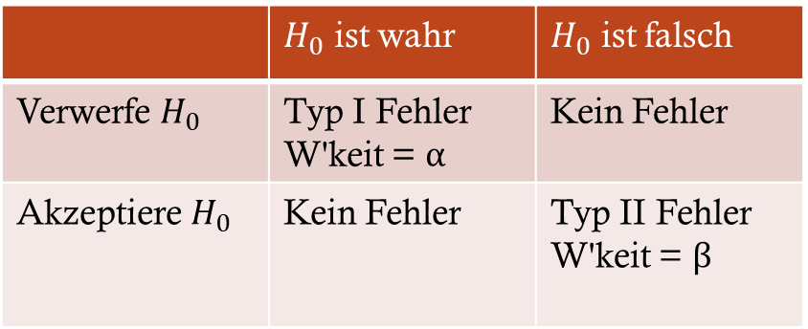
xy=n∑xiyi−∑xi∑yi√n∑x2i−(∑xi)2 √n∑y2i−(∑yi)2
 | $H_{0}$ ist wahr | $H_{0}$ ist falsch
Verwerfe $H_{0}$ | Typ I Fehler W'keit = α | Kein Fehler
Akzeptiere $H_{0}$ | Kein Fehler | Typ II Fehler W'keit = β
x | y
1 | 4
2 | 6
3 | 7
4 | 9
5 | 10
6 | ?

Slide 2
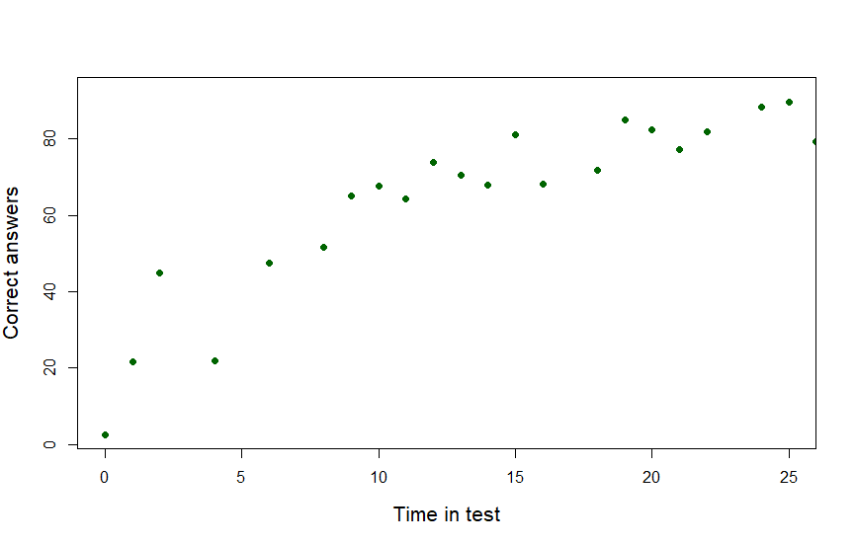
Polynomial regression

Slide 3
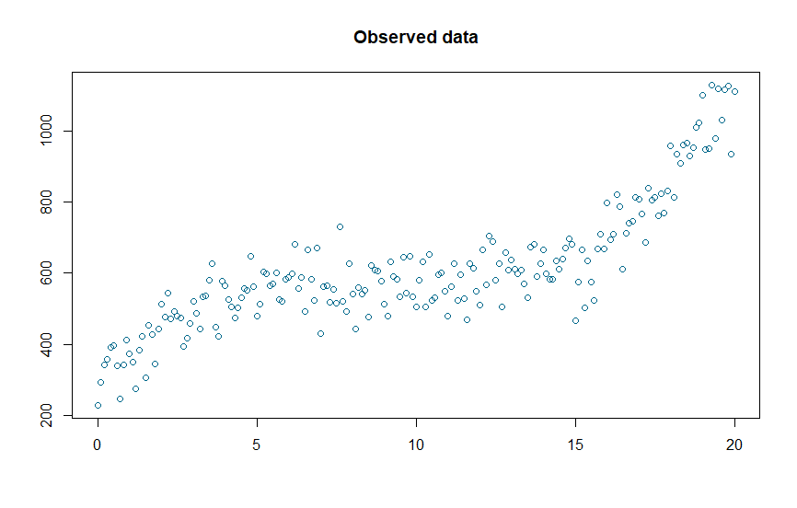
Polynomial regression

Slide 4

Polynomial regression

Slide 5
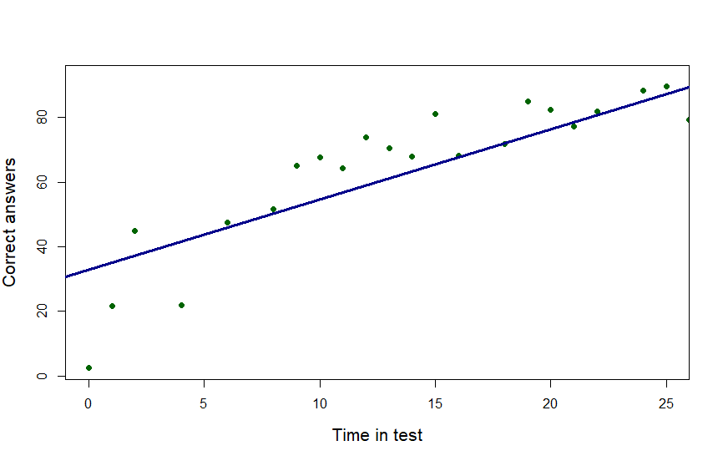

Polynomial regression

Slide 6
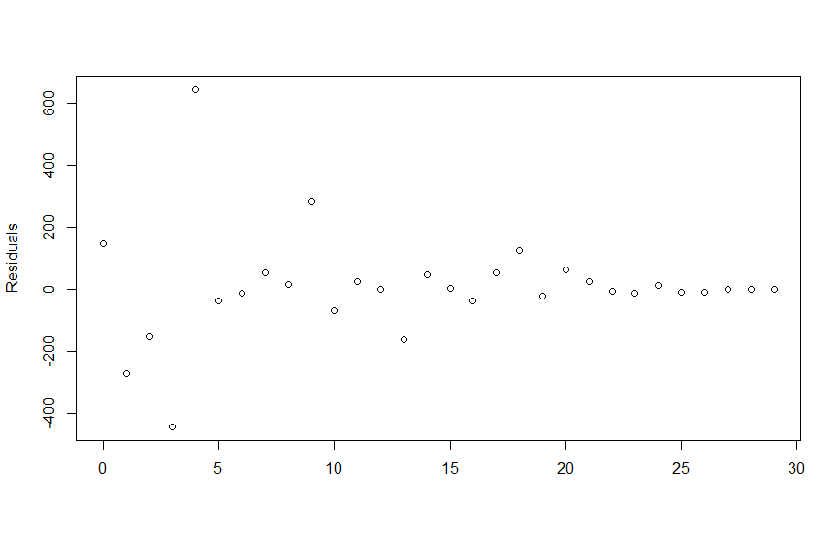
Polynomial regression

Slide 7
Polynomial regression

Slide 8
Polynomial regression

Slide 9
Polynomial regression

Slide 10

Polynomial regression

Slide 11

Polynomial regression

Slide 12
Polynomial regression

Slide 13

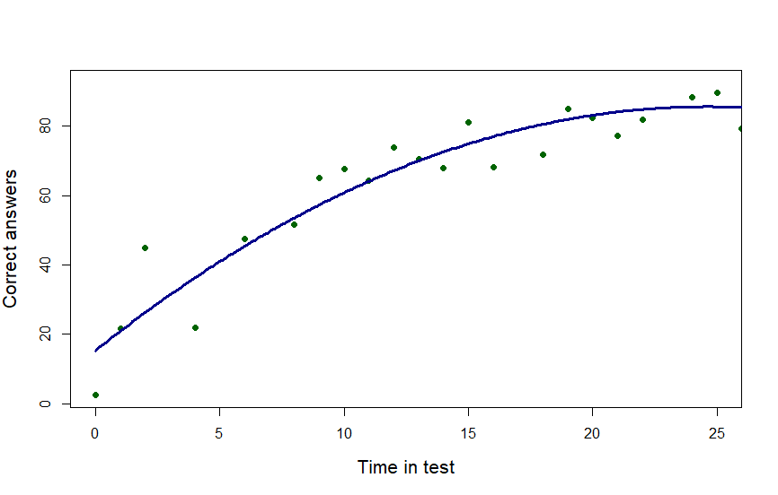
Polynomial regression

Slide 14
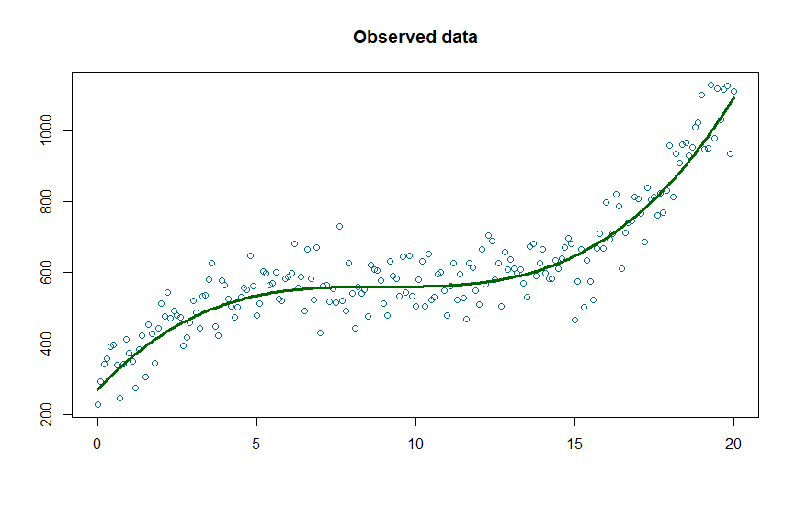
Polynomial regression
2nd order
3rd order

Slide 15
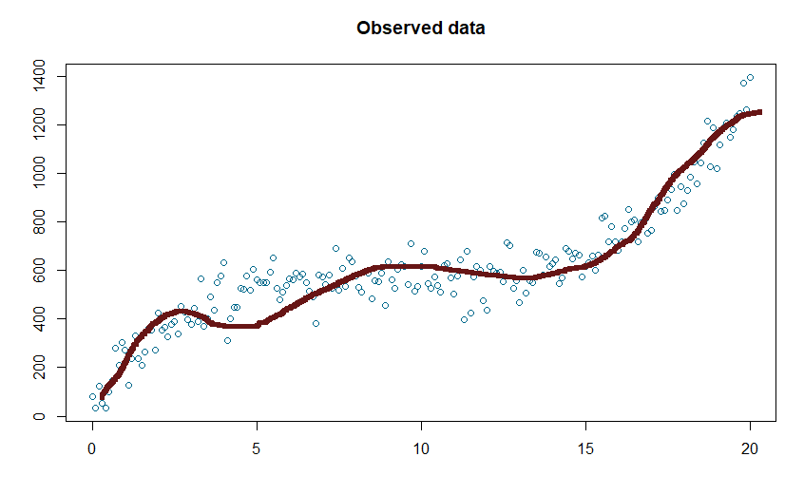
Polynomial regression
2nd order
n^{th} order

Slide 16
Bayes information criterion

Slide 17
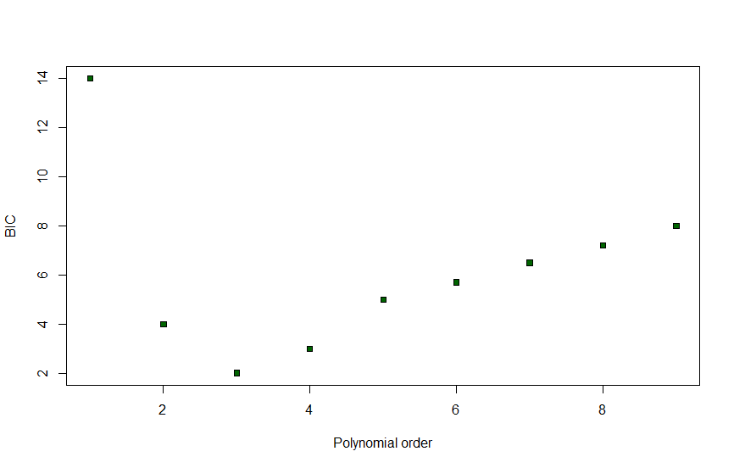
Bayes information criterion

Slide 18
Bayes information criterion
Improving model by using a higher order
Run the risk for overfitting
BIC criterion for model selection
aiming for a low score

Slide 19
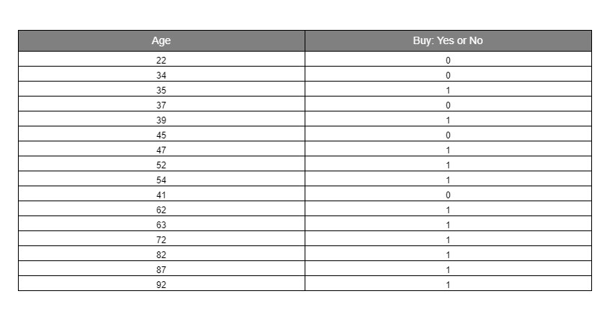
Logistic regression

Slide 20
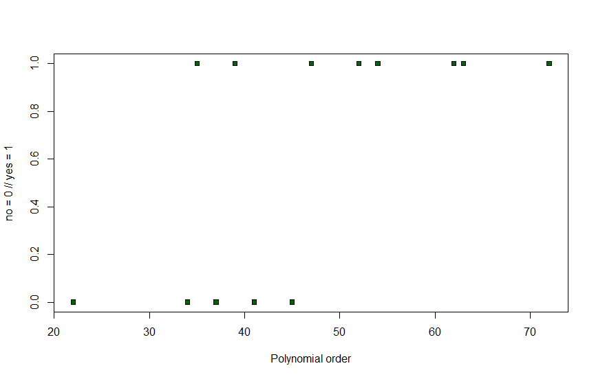
Logistic regression

Slide 21
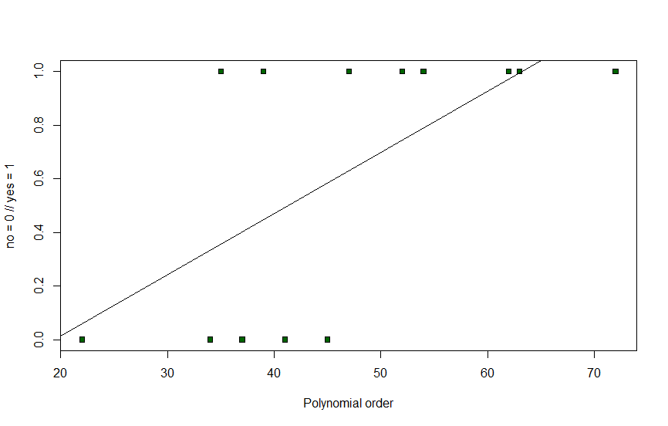
Logistic regression

Slide 22

Logistic regression

Slide 23
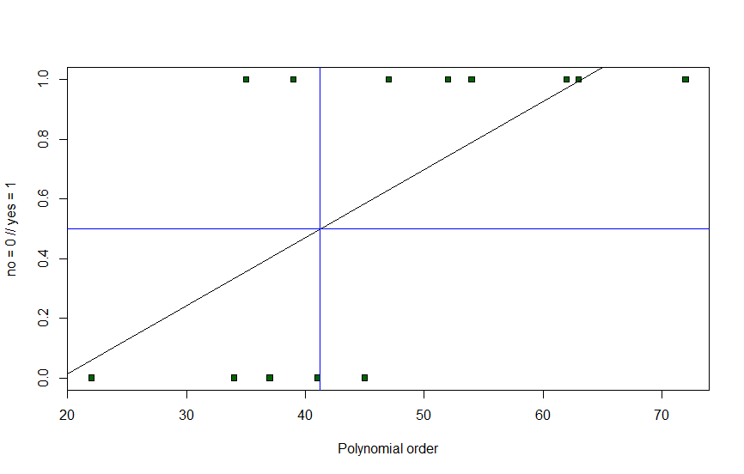
Logistic regression

Slide 24
Logistic regression
Decision border

Slide 25
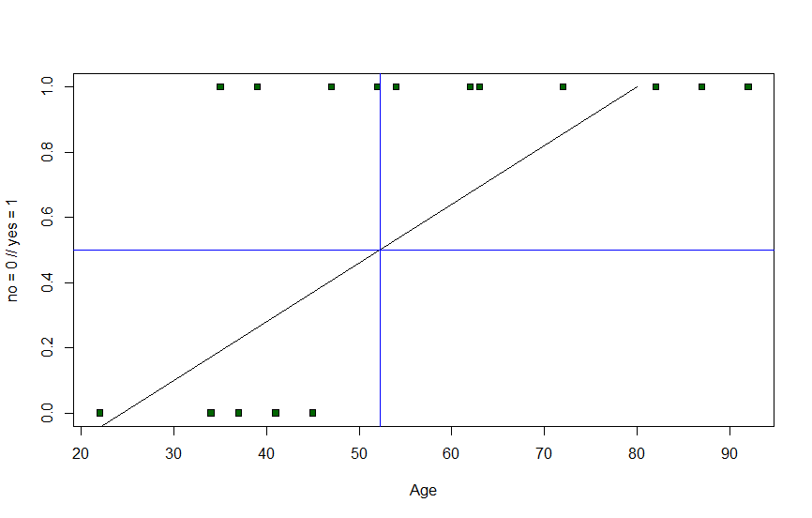
Logistic regression
Decision border

Slide 26
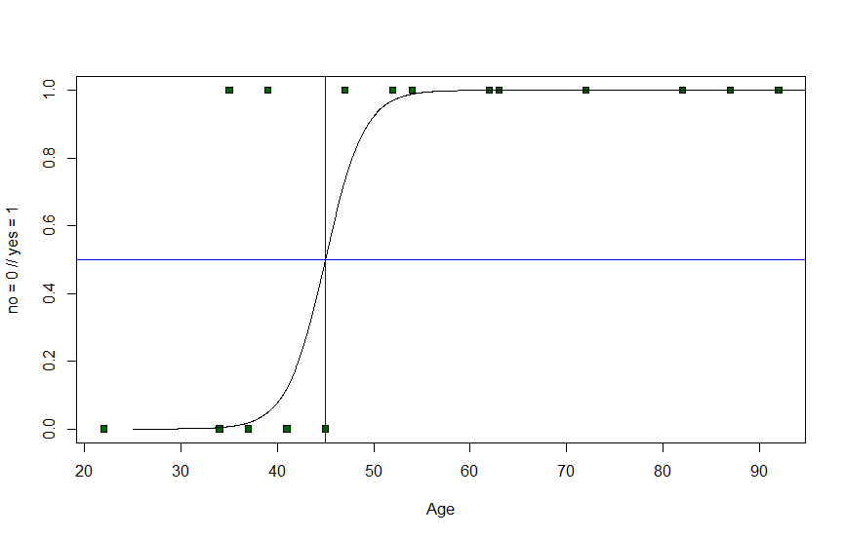
Logistic regression
Decision border

Slide 27
Logistic regression - formula
We need a positive function

Slide 28

Logistic regression - formula
We need a positive function

Slide 29
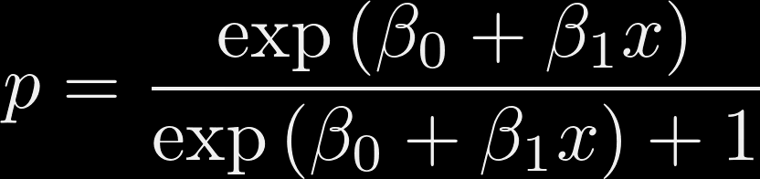
Logistic regression - formula
We need a positive function
0 < p < 1

Slide 30
Logistic regression - formula
We need a positive function
0 < p < 1

Slide 31
Logistic regression – real-life examples
Is an event occurring or not
Voting for a certain party: yes or no
Will a person buy or not buy

Slide 32
Logistic regression
Used for classifaction problems
(True or False, Approved or Not Approved, category 1 or category 2)

Slide 33
Logistic regression
Used for classifaction problems
(True or False, Approved or Not Approved, category 1 or category 2)
True and False is coded into 1 and 0

Slide 34
Logistic regression
Used for classifaction problems
(True or False, Approved or Not Approved, category 1 or category 2)
True and False is coded into 1 and 0
We can have one (for exp. Age) or multiple independent variables (Age, Weight, Income)

Slide 35
Logistic regression
Used for classifaction problems
(True or False, Approved or Not Approved, category 1 or category 2)
True and False is coded into 1 and 0
We can have one (for exp. Age) or multiple independent variables (Age, Weight, Income)

Slide 36
Decision trees

Slide 37
Decision trees
Do you feel sleepy?
TRUE
FALSE
Go to sleep.
Stay awake.

Slide 38
Decision trees
Do you feel sleepy?
TRUE
FALSE
Is it past 9pm?
Stay awake.
TRUE
FALSE
Go to sleep.
Take a nap.

Slide 39
Categories or numerical
Mouse > 30g
Do you feel sleepy?
TRUE
FALSE
TRUE
FALSE
Length >20cm
Length < 20cm
Take a nap.
Stay awake.

Slide 40
Categories or numerical
Mouse > 30g
Do you feel sleepy?
Numerical
Categorical
TRUE
FALSE
TRUE
FALSE
Length >20cm
Length < 20cm
Take a nap.
Stay awake.
Numerical
Categorical

Slide 41
Categories or numerical
Mouse > 30g
TRUE
FALSE
Age > 1 year
Color is grey.
TRUE
FALSE
TRUE
FALSE
Length > 20cm
Length of tail <5cm
Length < 15cm
Age > 1 year
TRUE
FALSE
TRUE
FALSE
Length < 20cm
Length > 20cm
Length < 20cm
Length > 20cm

Slide 42
Categories or numerical
Root Node
Mouse > 30g
Age > 1 year
Color is grey.
Length > 20cm
Length of tail <5cm
Length < 15cm
Age > 1 year
Length < 20cm
Length > 20cm
Length < 20cm
Length > 20cm

Slide 43
Categories or numerical
Root Node
Mouse > 30g
Age > 1 year
Color is grey.
Leaf Node
Length > 20cm
Length of tail <5cm
Length < 15cm
Age > 1 year
Length < 20cm
Length > 20cm
Length < 20cm
Length > 20cm

Slide 44
Example
Age > 1 year

Slide 45
Example
Chest Pain | High cholesterol | Male / Female | Heart Disease
YES | NO | MALE | YES
NO | NO | FEMALE | NO
NO | YES | FEMALE | NO
NO | YES | FEMALE | NO
NO | NO | MALE | NO
YES | YES | FEMALE | YES
NO | NO | MALE | NO
Age > 1 year

Slide 46
Example
Which is our Root Node?
Chest Pain | High chol | M / F | Heart Disease
YES | NO | M | YES
NO | NO | F | NO
NO | YES | F | NO
NO | YES | F | NO
NO | NO | M | NO
YES | YES | F | YES
NO | NO | M | NO
Age > 1 year

Slide 47
Example
Which is our Root Node?
Chest Pain | High chol | M / F | Heart Disease
YES | NO | M | YES
NO | NO | F | NO
NO | YES | F | NO
NO | YES | F | NO
NO | ? | M | NO
YES | YES | F | YES
NO | NO | M | NO
High Col
TRUE
FALSE
Heart Disease
YES: 79
NO: 34
Heart Disease
YES: 11
NO: 94

Slide 48
Example
Chest Pain
Which is our Root Node?
TRUE
FALSE
Chest Pain | High chol | M / F | Heart Disease
YES | NO | M | YES
NO | NO | F | NO
NO | YES | F | NO
NO | YES | F | NO
NO | NO | M | NO
YES | YES | F | YES
NO | NO | M | NO
Heart Disease
YES: 82
NO: 14
Heart Disease
YES: 7
NO: 99
High Col
TRUE
FALSE
Heart Disease
YES: 79
NO: 34
Heart Disease
YES: 11
NO: 94
Age > 1 year

Slide 49
Example
Chest Pain
Which is our Root Node?
TRUE
FALSE
Chest Pain | High chol | M / F | Heart Disease
YES | NO | M | YES
NO | NO | F | NO
NO | YES | F | NO
NO | YES | F | NO
NO | NO | M | NO
YES | YES | F | YES
NO | NO | M | NO
Heart Disease
YES: 82
NO: 14
Heart Disease
YES: 7
NO: 99
High Col
TRUE
FALSE
Gini Impurity!
Heart Disease
YES: 79
NO: 34
Heart Disease
YES: 11
NO: 94
Age > 1 year

Slide 50
Example
Which is our Root Node?
Gini for 1 leaf = 1- (prob. of "yes")² - (prob. of "no")²
Chest Pain | High chol | M / F | Heart Disease
YES | NO | M | YES
NO | NO | F | NO
NO | YES | F | NO
NO | YES | F | NO
NO | NO | M | NO
YES | YES | F | YES
NO | NO | M | NO
Chest Pain
TRUE
FALSE
Heart Disease
YES: 82
NO: 14
Heart Disease
YES: 7
NO: 99
High Col
TRUE
FALSE
Heart Disease
YES: 79
NO: 34
Heart Disease
YES: 11
NO: 94
Age > 1 year

Slide 51

Example
Which is our Root Node?
Gini for 1 leaf = 1- (prob. of "yes")² - (prob. of "no")²
Chest Pain | High chol | M / F | Heart Disease
YES | NO | M | YES
NO | NO | F | NO
NO | YES | F | NO
NO | YES | F | NO
NO | NO | M | NO
YES | YES | F | YES
NO | NO | M | NO
Chest Pain
1- ( $\frac{7}{7+99})$²
TRUE
FALSE
Heart Disease
YES: 82
NO: 14
Heart Disease
YES: 7
NO: 99
High Col
TRUE
FALSE
Heart Disease
YES: 79
NO: 34
Heart Disease
YES: 11
NO: 94
Age > 1 year

Slide 52

Example
Which is our Root Node?
Gini for 1 leaf = 1- (prob. of "yes")² - (prob. of "no")²
Chest Pain | High chol | M / F | Heart Disease
YES | NO | M | YES
NO | NO | F | NO
NO | YES | F | NO
NO | YES | F | NO
NO | NO | M | NO
YES | YES | F | YES
NO | NO | M | NO
Chest Pain
1- ( $\frac{7}{7+99})$²- ( $\frac{99}{7+99})$²
TRUE
FALSE
Heart Disease
YES: 82
NO: 14
Heart Disease
YES: 7
NO: 99
High Col
TRUE
FALSE
Heart Disease
YES: 79
NO: 34
Heart Disease
YES: 11
NO: 94
Age > 1 year

Slide 53

Example
Which is our Root Node?
Gini for 1 leaf = 1- (prob. of "yes")² - (prob. of "no")²
Chest Pain | High chol | M / F | Heart Disease
YES | NO | M | YES
NO | NO | F | NO
NO | YES | F | NO
NO | YES | F | NO
NO | NO | M | NO
YES | YES | F | YES
NO | NO | M | NO
Chest Pain
1- ( $\frac{7}{7+99})$²- ( $\frac{99}{7+99})$² = 0.123
TRUE
FALSE
Heart Disease
YES: 82
NO: 14
Heart Disease
YES: 7
NO: 99
High Col
TRUE
FALSE
Heart Disease
YES: 79
NO: 34
Heart Disease
YES: 11
NO: 94
Age > 1 year

Slide 54


Example
Which is our Root Node?
Gini for 1 leaf = 1- (prob. of "yes")² - (prob. of "no")²
Chest Pain | High chol | M / F | Heart Disease
YES | NO | M | YES
NO | NO | F | NO
NO | YES | F | NO
NO | YES | F | NO
NO | NO | M | NO
YES | YES | F | YES
NO | NO | M | NO
Chest Pain
1- ( $\frac{7}{7+99})$²- ( $\frac{99}{7+99})$² = 0.123
TRUE
FALSE
Heart Disease
YES: 82
NO: 14
Heart Disease
YES: 7
NO: 99
1- ( $\frac{82}{82+14})$²- ( $\frac{14}{82+14})$² = 0.249
High Col
TRUE
FALSE
Heart Disease
YES: 79
NO: 34
Heart Disease
YES: 11
NO: 94
Age > 1 year

Slide 55
Example
Which is our Root Node?
Gini for 1 leaf = 1- (prob. of "yes")² - (prob. of "no")²
Chest Pain | High chol | M / F | Heart Disease
YES | NO | M | YES
NO | NO | F | NO
NO | YES | F | NO
NO | YES | F | NO
NO | NO | M | NO
YES | YES | F | YES
NO | NO | M | NO
Chest Pain
1- ( $\frac{7}{7+99})$²- ( $\frac{99}{7+99})$² = 0.123
TRUE
FALSE
Heart Disease
YES: 82
NO: 14
Heart Disease
YES: 7
NO: 99
1- ( $\frac{82}{82+14})$²- ( $\frac{14}{82+14})$² = 0.249
Gini = 0.249
Gini = 0.123
Age > 1 year

Slide 56

Example
Which is our Root Node?
Gini for 1 leaf = 1- (prob. of "yes")² - (prob. of "no")²
Chest Pain | High chol | M / F | Heart Disease
YES | NO | M | YES
NO | NO | F | NO
NO | YES | F | NO
NO | YES | F | NO
NO | NO | M | NO
YES | YES | F | YES
NO | NO | M | NO
Chest Pain
1- ( $\frac{7}{7+99})$²- ( $\frac{99}{7+99})$² = 0.123
TRUE
FALSE
Heart Disease
YES: 82
NO: 14
Heart Disease
YES: 7
NO: 99
Gini = 0.249
Gini = 0.123
( $\frac{96}{96+106})∗0.249$ + ( $\frac{106}{96+106})$ $∗$ 0.123 = 0.183
Age > 1 year

Slide 57

Example
Which is our Root Node?
Gini for 1 leaf = 1- (prob. of "yes")² - (prob. of "no")²
Chest Pain | High chol | M / F | Heart Disease
YES | NO | M | YES
NO | NO | F | NO
NO | YES | F | NO
NO | YES | F | NO
NO | NO | M | NO
YES | YES | F | YES
NO | NO | M | NO
Chest Pain
1- ( $\frac{7}{7+99})$²- ( $\frac{99}{7+99})$² = 0.123
TRUE
FALSE
Heart Disease
YES: 82
NO: 14
Heart Disease
YES: 7
NO: 99
Gini = 0.249
Gini = 0.123
Gini Impurity for Chest Pain
( $\frac{96}{96+107})∗0.249$ + ( $\frac{107}{96+107})$ $∗$ 0.123 = 0.183

Slide 58
Example
Which is our Root Node?
Gini for 1 leaf = 1- (prob. of "yes")² - (prob. of "no")²
Chest Pain | High chol | M / F | Heart Disease
YES | NO | M | YES
NO | NO | F | NO
NO | YES | F | NO
NO | YES | F | NO
NO | NO | M | NO
YES | YES | F | YES
NO | NO | M | NO
1- ( $\frac{7}{7+99})$²- ( $\frac{99}{7+99})$² = 0.123
High Col
TRUE
FALSE
Heart Disease
YES: 79
NO: 34
Heart Disease
YES: 11
NO: 94
Gini Impurity for Chest Pain
0.183
Gini Impurity for High Col
0.309

Slide 59
Example
Which is our Root Node?
Gini for 1 leaf = 1- (prob. of "yes")² - (prob. of "no")²
Chest Pain | High chol | M / F | Heart Disease
YES | NO | M | YES
NO | NO | F | NO
NO | YES | F | NO
NO | YES | F | NO
NO | NO | M | NO
YES | YES | F | YES
NO | NO | M | NO
1- ( $\frac{7}{7+99})$²- ( $\frac{99}{7+99})$² = 0.123
High Col
TRUE
FALSE
Heart Disease
YES: 79
NO: 34
Heart Disease
YES: 11
NO: 94
Gini Impurity for Chest Pain
0.183
Gini Impurity for High Col
0.309
Gini Impurity for M/F
0.422

Slide 60
Example
Which is our Root Node?
Gini for 1 leaf = 1- (prob. of "yes")² - (prob. of "no")²
Chest Pain | High chol | M / F | Heart Disease
YES | NO | M | YES
NO | NO | F | NO
NO | YES | F | NO
NO | YES | F | NO
NO | NO | M | NO
YES | YES | F | YES
NO | NO | M | NO
1- ( $\frac{7}{7+99})$²- ( $\frac{99}{7+99})$² = 0.123
High Col
TRUE
FALSE
Heart Disease
YES: 79
NO: 34
Heart Disease
YES: 11
NO: 94
Gini Impurity for Chest Pain
0.183
Gini Impurity for High Col
0.309
Gini Impurity for M/F
0.622

Slide 61
Example
Which is our Root Node?
Chest Pain
Chest Pain | High chol | M / F | Heart Disease
YES | NO | M | YES
NO | NO | F | NO
NO | YES | F | NO
NO | YES | F | NO
NO | NO | M | NO
YES | YES | F | YES
NO | NO | M | NO
TRUE
FALSE

Slide 62
Example
Which is our Root Node?
Chest Pain
Chest Pain | High chol | M / F | Heart Disease
YES | NO | M | YES
NO | NO | F | NO
NO | YES | F | NO
NO | YES | F | NO
NO | NO | M | NO
YES | YES | F | YES
NO | NO | M | NO
TRUE
FALSE

Slide 63
Example
Which is our Root Node?
Chest Pain
Chest Pain | High chol | M / F | Heart Disease
YES | NO | M | YES
NO | NO | F | NO
NO | YES | F | NO
NO | YES | F | NO
NO | NO | M | NO
YES | YES | F | YES
NO | NO | M | NO
TRUE
FALSE
Gini Impurity for High Col
High Col
0.156
TRUE
FALSE
Heart Disease
YES: 76
NO: 9
Heart Disease
YES: 6
NO: 84

Slide 64
Example
Which is our Root Node?
Chest Pain
Chest Pain | High chol | M / F | Heart Disease
YES | NO | M | YES
NO | NO | F | NO
NO | YES | F | NO
NO | YES | F | NO
NO | NO | M | NO
YES | YES | F | YES
NO | NO | M | NO
TRUE
FALSE
Gini Impurity for High Col
High Col
0.156
Gini Impurity for M / F
M / F
0.526

Slide 65
Example
Which is our Root Node?
Chest Pain
Chest Pain | High chol | M / F | Heart Disease
YES | NO | M | YES
NO | NO | F | NO
NO | YES | F | NO
NO | YES | F | NO
NO | NO | M | NO
YES | YES | F | YES
NO | NO | M | NO
TRUE
FALSE
Gini Impurity for High Col
High Col
0.156
Gini Impurity for M / F
M / F
0.526
Gini Impurity for High Col
0.156
Gini Impurity for Chest Pain
<
0.249

Slide 66
Example
Chest Pain
Chest Pain | High chol | M / F | Heart Disease
YES | NO | M | YES
NO | NO | F | NO
NO | YES | F | NO
NO | YES | F | NO
NO | NO | M | NO
YES | YES | F | YES
NO | NO | M | NO
TRUE
FALSE
High Col
TRUE
FALSE
Steps to find the tree:
Calculate the Gini Scores
If the node has itself has the lowest score – it becomes a leaf
If not pick the characteristic with lowest score as the next node
Start with 1) considering only the relevant data

Slide 67
Example
How about numerical columns?
Age | Heart Disease
64 | YES
32 | NO
22 | NO
57 | NO
77 | NO
92 | NO
68 | NO
Age > 1 year

Slide 68
Example
How about numerical columns?
1) Sort the data in descending order
Age | Heart Disease
92 | NO
77 | NO
68 | NO
64 | YES
57 | NO
32 | NO
22 | NO
Age > 1 year

Slide 69
Example
How about numerical columns?
Sort the data in descending order
Calculate the Gini Score for different splits
Age | Heart Disease
92 | NO
77 | NO
68 | NO
64 | YES
57 | NO
32 | NO
22 | NO
Gini Score = ??
Age > 1 year

Slide 70
Example
How about numerical columns?
Sort the data in descending order
Calculate the Gini Score for different splits
Age | Heart Disease
92 | NO
77 | NO
68 | NO
64 | YES
57 | NO
32 | NO
22 | NO
Gini Score = ??
Gini Score = ??
Age > 1 year

Slide 71
Example
How about numerical columns?
Sort the data in descending order
Calculate the Gini Score for different splits
Use the lowest Gini Score for a Split
Age | Heart Disease
92 | NO
77 | NO
68 | NO
64 | YES
57 | NO
32 | NO
22 | NO
Gini Score = 0.23
Gini Score = 0.21
Gini Score = 0.29
Gini Score = 0.45
Gini Score = 0.31
Gini Score = 0.38
Age > 1 year

Slide 72
Example
How about numerical columns?
Sort the data in descending order
Calculate the Gini Score for different splits
Use the lowest Gini Score for a Split
Age | Heart Disease
92 | NO
77 | NO
68 | NO
64 | YES
57 | NO
32 | NO
22 | NO
Gini Score = 0.23
Gini Score = 0.21
Gini Score = 0.29
Age <= 77
Gini Score = 0.45
TRUE
FALSE
Gini Score = 0.31
Gini Score = 0.38
Age > 1 year

Slide 73
Example
How about multiple choice categories?
Favorite Animal | Likes Statistics
Cats | NO
Dogs | NO
Birds | NO
Dogs | YES
Cats | NO
Cats | NO
Dogs | NO
Age > 1 year

Slide 74
Example
How about multiple choice categories?
Favorite Animal | Likes Statistics
Cats | NO
Dogs | NO
Birds | NO
Dogs | YES
Cats | NO
Cats | NO
Dogs | NO
Cat
Dogs
Birds
Gini Score = ??
Gini Score = ??
Gini Score = ??
Age > 1 year

Slide 75
Example
How about multiple choice categories?
Favorite Animal | Likes Statistics
Cats | NO
Dogs | NO
Birds | NO
Dogs | YES
Cats | NO
Cats | NO
Dogs | NO
Cat
Dogs
Birds
Gini Score = ??
Gini Score = ??
Gini Score = ??
Cats or Dogs
Birds or Dogs
Cats or Bidrs
Gini Score = ??
Gini Score = ??
Gini Score = ??
Age > 1 year

Slide 76
Example
How about multiple choice categories?
Favorite Animal | Likes Statistics
Cats | NO
Dogs | NO
Birds | NO
Dogs | YES
Cats | NO
Cats | NO
Dogs | NO
Cat
Dogs
Birds
Gini Score = ??
Gini Score = ??
Gini Score = ??
Cats or Dogs
Birds or Dogs
Cats or Birds
Gini Score = ??
Gini Score = ??
Gini Score = ??
NOTE: Cats OR Dogs OR Birds doesn't need to be calculated since this includes everyone
Age > 1 year

Slide 77
Regression Trees
Temperature

Slide 78
Regression Trees
Temperature

Slide 79
Regression Trees
Temperature

Slide 80
Regression Trees
Temperature

Slide 81
Regression Trees
Temperature

Slide 82
Regression Trees
Temperature

Slide 83
Regression Trees
Temp < 10
0 Players
Temp < 20
7 Players
10 Players

Slide 84
Regression Trees
Temperature

Slide 85
Regression Trees
Temperature

Slide 86
Regression Trees
Temperature

Slide 87
Regression Trees
Temp >= 10

Slide 88
Regression Trees
Temperature

Slide 89
Regression Trees
Temperature

Slide 90
Regression Trees
Temperature
Minimum number of data points (ex. 5)

Slide 91
Regression Trees
Temp >= 10
0 Players

Slide 92
Regression Trees
Temperature
Minimum number of data points (ex. 5)

Slide 93
Regression Trees
Temperature
Minimum number of data points (ex. 5)

Slide 94
Regression Trees
Temp >= 10
0 Players
Temp <= 16
7.75 Players
0 Players
Mean = (7+7+8+9) / 4 =7.75

Slide 95
Regression Trees
Temp >= 10
0 Players
Temp <= 16
8 Players
0 Players

Slide 96
Example
Temperature | Golf Players
0 | 0
3 | 0
5 | 0
6 | 1
8 | 1
10 | 7
12 | 9
13 | 8
15 | 7
17 | 10
18 | 10
20 | 10
23 | 10
How about multiple categories?
Cat
Dogs
Birds
Gini Score = ??
Gini Score = ??
Gini Score = ??
Age > 1 year

Slide 97
Regression Trees
Rain | Wind | Temperature | Golf Players
YES | 50 | 0 | 0
NO | 40 | 3 | 0
NO | 32 | 5 | 0
NO | 66 | 6 | 1
YES | 22 | 8 | 1
NO | 33 | 10 | 7
NO | 46 | 12 | 9
NO | 2 | 13 | 8
NO | 12 | 15 | 7
NO | 4 | 17 | 10
NO | 5 | 18 | 10
NO | 3 | 20 | 10
NO | 5 | 23 | 10
How about multiple categories?
Temperature

Slide 98
Regression Trees
Rain | Wind | Temperature | Golf Players
YES | 50 | 0 | 0
NO | 40 | 3 | 0
NO | 32 | 5 | 0
NO | 66 | 6 | 1
YES | 22 | 8 | 1
NO | 33 | 10 | 7
NO | 46 | 12 | 9
NO | 2 | 13 | 8
NO | 12 | 15 | 7
NO | 4 | 17 | 10
NO | 5 | 18 | 10
NO | 3 | 20 | 10
NO | 5 | 23 | 10
How about multiple categories?
Temperature

Slide 99
Regression Trees
Rain | Wind | Temperature | Golf Players
YES | 50 | 0 | 0
NO | 40 | 3 | 0
NO | 32 | 5 | 0
NO | 66 | 6 | 1
YES | 22 | 8 | 1
NO | 33 | 10 | 7
NO | 46 | 12 | 9
NO | 2 | 13 | 8
NO | 12 | 15 | 7
NO | 4 | 17 | 10
NO | 5 | 18 | 10
NO | 3 | 20 | 10
NO | 5 | 23 | 10
How about multiple categories?
Calculate the sum of squared residuals
Temperature

Slide 100
Regression Trees
Rain | Wind | Temperature | Golf Players
YES | 50 | 0 | 0
NO | 40 | 3 | 0
NO | 32 | 5 | 0
NO | 66 | 6 | 1
YES | 22 | 8 | 1
NO | 33 | 10 | 7
NO | 46 | 12 | 9
NO | 2 | 13 | 8
NO | 12 | 15 | 7
NO | 4 | 17 | 10
NO | 5 | 18 | 10
NO | 3 | 20 | 10
NO | 5 | 23 | 10
How about multiple categories?
Calculate the sum of squared residuals
… for every split!
Temperature

Slide 101
Regression Trees
Rain | Wind | Temperature | Golf Players
YES | 50 | 0 | 0
NO | 40 | 3 | 0
NO | 32 | 5 | 0
NO | 66 | 6 | 1
YES | 22 | 8 | 1
NO | 33 | 10 | 7
NO | 46 | 12 | 9
NO | 2 | 13 | 8
NO | 12 | 15 | 7
NO | 4 | 17 | 10
NO | 5 | 18 | 10
NO | 3 | 20 | 10
NO | 5 | 23 | 10
How about multiple categories?
Find again the best split in regards to sum of squared
remember as a candidate!
Temperature

Slide 102
Regression Trees
Rain | Wind | Temperature | Golf Players
YES | 50 | 0 | 0
NO | 40 | 3 | 0
NO | 32 | 5 | 0
NO | 66 | 6 | 1
YES | 22 | 8 | 1
NO | 33 | 10 | 7
NO | 46 | 12 | 9
NO | 2 | 13 | 8
NO | 12 | 15 | 7
NO | 4 | 17 | 10
NO | 5 | 18 | 10
NO | 3 | 20 | 10
NO | 5 | 23 | 10
How about multiple categories?
Move on to the next possible category!
Wind

Slide 103
Regression Trees
Rain | Wind | Temperature | Golf Players
YES | 50 | 0 | 0
NO | 40 | 3 | 0
NO | 32 | 5 | 0
NO | 66 | 6 | 1
YES | 22 | 8 | 1
NO | 33 | 10 | 7
NO | 46 | 12 | 9
NO | 2 | 13 | 8
NO | 12 | 15 | 7
NO | 4 | 17 | 10
NO | 5 | 18 | 10
NO | 3 | 20 | 10
NO | 5 | 23 | 10
How about multiple choice categories?
Go to the last category – only one possible split:
… again we calculate the SR.
Temperature

Slide 104
Regression Trees
Rain | Wind | Temperature | Golf Players
YES | 50 | 0 | 0
NO | 40 | 3 | 0
NO | 32 | 5 | 0
NO | 66 | 6 | 1
YES | 22 | 8 | 1
NO | 33 | 10 | 7
NO | 46 | 12 | 9
NO | 2 | 13 | 8
NO | 12 | 15 | 7
NO | 4 | 17 | 10
NO | 5 | 18 | 10
NO | 3 | 20 | 10
NO | 5 | 23 | 10
How about multiple choice categories?
Compare the SR for the best splits…
Temperature

Slide 105
Regression Trees
Rain | Wind | Temperature | Golf Players
YES | 50 | 0 | 0
NO | 40 | 3 | 0
NO | 32 | 5 | 0
NO | 66 | 6 | 1
YES | 22 | 8 | 1
NO | 33 | 10 | 7
NO | 46 | 12 | 9
NO | 2 | 13 | 8
NO | 12 | 15 | 7
NO | 4 | 17 | 10
NO | 5 | 18 | 10
NO | 3 | 20 | 10
NO | 5 | 23 | 10
How about multiple choice categories?
… the best one will be our first split…
Temperature

Slide 106
Regression Trees
Rain | Wind | Temperature | Golf Players
YES | 50 | 0 | 0
NO | 40 | 3 | 0
NO | 32 | 5 | 0
NO | 66 | 6 | 1
YES | 22 | 8 | 1
NO | 33 | 10 | 7
NO | 46 | 12 | 9
NO | 2 | 13 | 8
NO | 12 | 15 | 7
NO | 4 | 17 | 10
NO | 5 | 18 | 10
NO | 3 | 20 | 10
NO | 5 | 23 | 10
How about multiple choice categories?
… for the two new categories we do the same
thing again…
Temperature

Slide 107
Regression Trees
Easy and intuitively to understand – comprehensible

Slide 108
Decision Tree
Easy and intuitively to understand – comprehensible
Low effort in terms of data preparation

Slide 109
Decision Tree
Easy and intuitively to understand – comprehensible
Low effort in terms of data preparation
Missing values are not affecting building a tree

Slide 110
Decision Tree
Advantages:
Easy and intuitively to understand – comprehensible
Low effort in terms of data preparation
Missing values are not affecting building a tree
Disadvantages:

Slide 111
Decision Tree
Advantages:
Easy and intuitively to understand – comprehensible
Low effort in terms of data preparation
Missing values are not affecting building a tree
Advantages:
Calculations can be more complex than for other algorithms

Slide 112
Decision Tree
Advantages:
Easy and intuitively to understand – comprehensible
Low effort in terms of data preparation
Missing values are not affecting building a tree
Disadvantages:
Calculations can be more complex than for other algorithms
Higher time to train the model

Slide 113
Decision Tree
Advantages:
Easy and intuitively to understand – comprehensible
Low effort in terms of data preparation
Missing values are not affecting building a tree
Disadvantages:
Calculations can be more complex than for other algorithms
Higher time to train the model
Small change in data can result in large change of tree structure -> instability

Slide 114
Random Forest

Slide 115
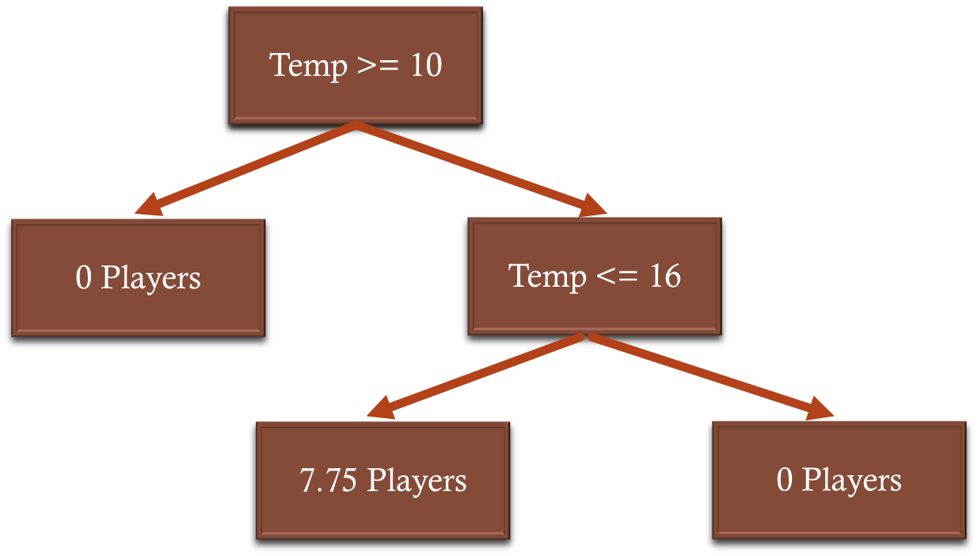
Random Forest
Based on Decision Tree

Slide 116
Random Forest
Problem:
Trees are not very robust

Slide 117
Random Forest
Problem:
Trees are not very robust
Easily lead to overfitting

Slide 118
Random Forest
Problem:
Trees are not very robust
Easily lead to overfitting
-> low SR for training data but often
Times not good with new data

Slide 119
Random Forest
Based on many Decision Trees

Slide 120
Random Forest
… more but less complex trees than just one very complex

Slide 121
Random Forest
… reduces complexity … lower chance of overfitting

Slide 122
Random Forest
Random subset for features in each split…

Slide 123
Random Forest
Different hyperparameters (=how many splits,
min number of data points in one node etc.)

Slide 124
Random Forest
Results of the single trees will be combined

Slide 125
Ensemble methods
Data
BAGGING | BOOSTING
Randomly (with replacement choose data to train different trees)
Parallel training

Slide 126
Ensemble methods
Data
BAGGING | BOOSTING
Randomly (with replacement choose data to train different trees)
Parallel training
New data:
Result for all tree – mean of all results

Slide 127
Ensemble methods
Data
BAGGING | BOOSTING
Randomly (with replacement choose data to train different trees) | Learning from the mistakes
Parallel training | Sequential

Slide 128
Ensemble methods
Data
BAGGING | BOOSTING
Randomly (with replacement choose data to train different trees) | Learning from the mistakes
Parallel training | Sequential

Slide 129
Ensemble methods
Data
BAGGING | BOOSTING
Randomly (with replacement choose data to train different trees) | Learning from the mistakes
Parallel training | Sequential
Focus on the mistakes

Slide 130
Ensemble methods
Data
BAGGING | BOOSTING
Randomly (with replacement choose data to train different trees) | Learning from the mistakes
Parallel training | Sequential
Every tree gets a score

Slide 131
Ensemble methods
Data
BAGGING | BOOSTING
Randomly (with replacement choose data to train different trees) | Learning from the mistakes
Parallel training | Sequential
This score is used to calculate
the weighted average

Slide 132
Ensemble methods
Data
BAGGING | BOOSTING
Randomly (with replacement choose data to train different trees) | Learning from the mistakes
Parallel training | Sequential

Slide 133
How about classification problems?
Data
Every tree can vote for "yes" or "no"

Slide 134
Hyperparameters
Number of trees constructed
Max depth of trees
Min number of samples per leaf node

Slide 135
Decision trees
Do you feel sleepy?
Go to bed.
Stay awake.
TRUE
FALSE

Slide 136
Decision trees
TRUE
Do you feel sleepy?
Is it past 9pm?
Stay awake.
Sleep.
Stay awake.
FALSE

